Slide 1
Naïve Bayes Classification

Slide 2
Things We’d Like to Do
Spam Classification
  Given an email, predict whether it is spam or not
Medical Diagnosis
  Given a list of symptoms, predict whether a patient has disease X or not
Weather
  Based on temperature, humidity, etc… predict if it will rain tomorrow

Slide 3
A Little Bit of Probability
Conditional Probability and Bayes’ Theorem

Slide 4
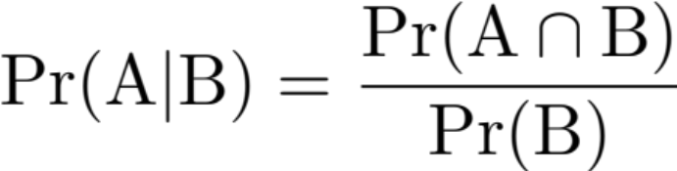


Conditional Probability
Conditional probability:
  The probability of A given B
  The proportion of A and B in B
Conditional operator | “word flags”:
  if, given, of the
Pr(A)
Note consequence:
Pr(B)

Slide 5
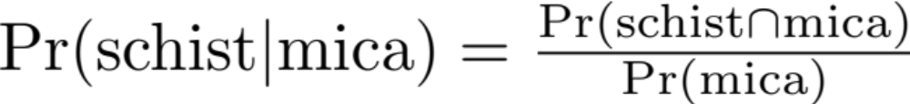
Example
In a large soil database 72% of the of the samples contain mica and 43% mica and schist. Assuming the database reflective of a relevant population, what is the probability that a randomly selected soil sample (from the same population) that contains mica also contains schist?

Slide 6
Example
= 43%
= 72%
= 0.43/0.72
= 0.597
≈ 60% chance

Slide 7
Multiplication Rule
Another important consequence of conditional probability is the multiplication rule:

Slide 8
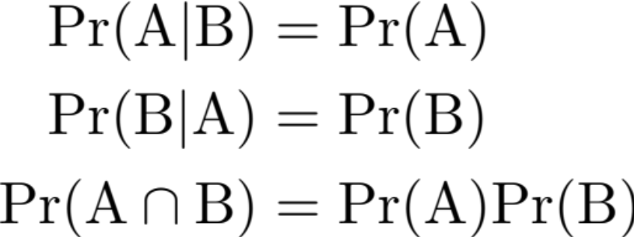
Statistical Independence
If A is independent of B then the probability of A is not affected by knowledge of B.
If A and B are statistically independent if:
If A and B do not satisfy the above they are statistically dependent

Slide 9





Example
Using the information from the large soil database:
72% of the of the samples contain mica
43% contain mica and schist.
100% contain mica or schist
Compute:

Slide 10
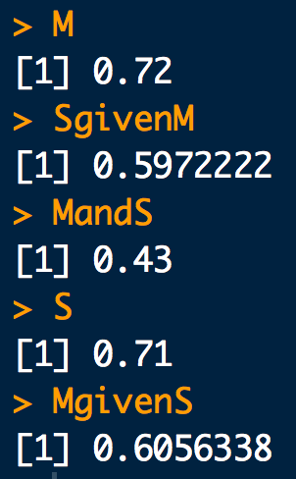
Example
# Data from the question:
M <- 0.72 # Schist
MandS <- 0.43 # Mica and Schist
# Pr(M)
M
# Pr(S|M) = Pr(SandM)/Pr(M)
SgivenM <- MandS/M
SgivenM
# Pr(S and M) = Pr(M and S)
MandS
# Pr(S) = Pr(S or M) + Pr(S and M) - Pr(M)
S <- 1 + 0.43 - 0.72
S
# Pr(M|S) = Pr(M and S)/Pr(S)
MgivenS <- 0.43/S
MgivenS
Notes:
REPLACE WITH HAND CALC

Slide 11




The Law of Total Probability
Suppose a sample space can be partitioned into a set of disjoint events B_{i} such that
B₁
B₄
B₃
A
B₂

Slide 12
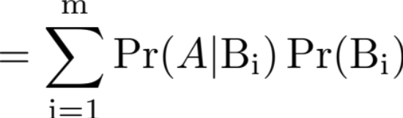
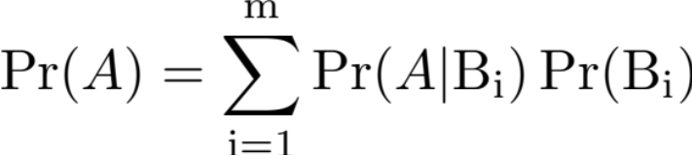
The Law of Total Probability
Suppose a sample space can be partitioned into a set of disjoint events B_{i} such that
  The probability of an arbitrary event A in Ω can be written as:
Law of total probability

Slide 13
Example: A medical test
Professor P LOVES hamburgers. But he’s also a hypochondriac. He thinks he is infected with “Mad Cow Disease” (MCD), so he gets himself tested (T).
  The true positive rate of the test is: Pr(T⁺ | MCD⁺) = 0.7
  The false positive rate of the test is: Pr(T⁺ | MCD⁻) = 0.1
  The background prevalence of MCD in the yummy cow population is: Pr(MCD⁺) = 0.02
What is the probability that Prof. P tests positive for MCD, Pr(T⁺)?

Slide 14
Example: A medical test
# Data from the question:
Tp.given.MCDp <- 0.7
Tp.given.MCDm <- 0.1
MCDp <- 0.02
# Pr(T+) = Pr(T+ | MCD+) Pr(MCD+) + Pr(T+ | MCD-) Pr(MCD-)
Tp.given.MCDp * MCDp + Tp.given.MCDm * (1-MCDp)
Notes:
REPLACE WITH HAND CALC

Slide 15


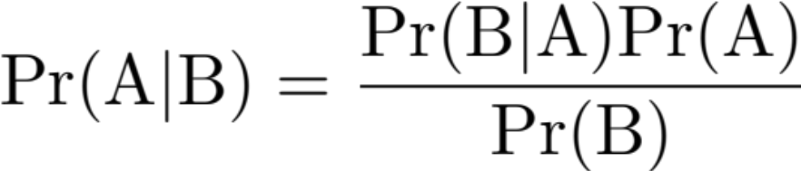
There’s more than one way to condition:
Bayes’ Theorem
Intersection commutes:
  So:
  But from the multiplication rule we know:
  So:
Bayes’ Theorem

Slide 16
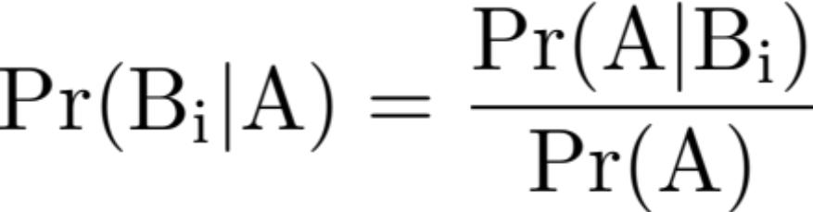
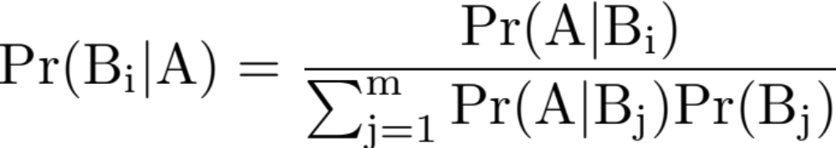
Bayes’ Theorem
A slightly more general form for Bayes’ Theorem:
  Suppose a sample space can be partitioned into a set of disjoint events B_{i} such that

Slide 17
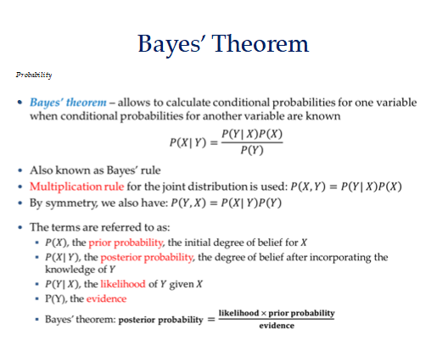

Slide 18
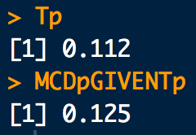
Example: A medical test again…
Suppose Professor P is positive for MCD. What is the probability that he truly has MCD, Pr(MCD⁺| T⁺)?
# Data from the question:
Tp.given.MCDp <- 0.7
Tp.given.MCDm <- 0.1
MCDp <- 0.02
# Pr(T+) = Pr(T+ | MCD+) Pr(MCD+) + Pr(T+ | MCD-) Pr(MCD-)
Tp <- Tp.given.MCDp * MCDp + Tp.given.MCDm * (1-MCDp)
Tp
# Pr(MCD+ | T+) = Pr(T+ | MCD+) Pr(MCD+) / Pr(T+)
(Tp.given.MCDp * MCDp)/Tp
Notes:
REPLACE WITH HAND CALC

Slide 19
Bayesian Classification
Problem statement:
  Given features X₁,X₂,…,X_{n}
  Predict a label Y

Slide 20
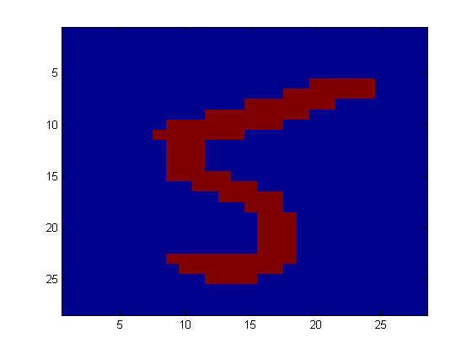
Another Application
Digit Recognition
X₁,…,X_{n} ∈ {0,1} (Black vs. White pixels)
Y ∈ {5,6} (predict whether a digit is a 5 or a 6)
Classifier
5

Slide 21

The Bayes Classifier
A good strategy is to predict:
  (for example: what is the probability that the image represents a 5 given its pixels?)
So … How do we compute that?

Slide 22
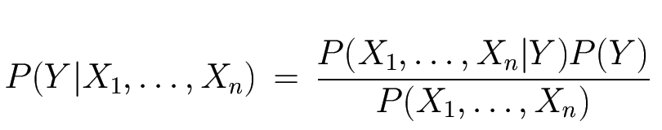
The Bayes Classifier
Use Bayes Rule!
Why did this help? Well, we think that we might be able to specify how features are “generated” by the class label
Likelihood
Prior
Normalization Constant

Slide 23
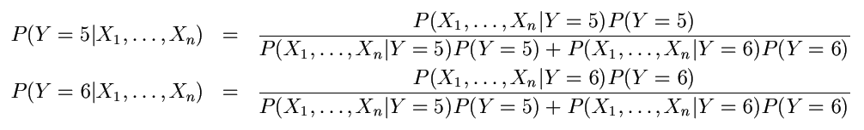
The Bayes Classifier
Let’s expand this for our digit recognition task:
To classify, we’ll simply compute these two probabilities and predict based on which one is greater

Slide 24
Model Parameters
For the Bayes classifier, we need to “learn” two functions, the likelihood and the prior
How many parameters are required to specify the prior for our digit recognition example?

Slide 25
Model Parameters
How many parameters are required to specify the likelihood?
  (Supposing that each image is 30x30 pixels)
  ?

Slide 26
Model Parameters
The problem with explicitly modeling P(X₁,…,X_{n}|Y) is that there are usually way too many parameters:
  We’ll run out of space
  We’ll run out of time
  And we’ll need tons of training data (which is usually not available)

Slide 27
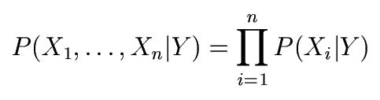
The Naïve Bayes Model
The Naïve Bayes Assumption: Assume that all features are independent given the class label Y
Equationally speaking:
(We will discuss the validity of this assumption later)

Slide 28
Why is this useful?
# of parameters for modeling P(X₁,…,X_{n}|Y):
  2(2^{n}-1)
# of parameters for modeling P(X₁|Y),…,P(X_{n}|Y)
  2n

Slide 29
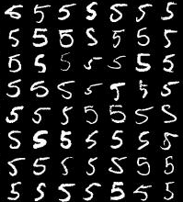
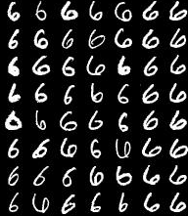
Naïve Bayes Training
Now that we’ve decided to use a Naïve Bayes classifier, we need to train it with some data:
MNIST Training Data

Slide 30
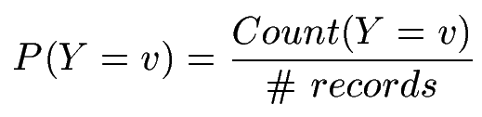

Naïve Bayes Training
Training in Naïve Bayes is easy:
  Estimate P(Y=v) as the fraction of records with Y=v
  Estimate P(X_{i}=u|Y=v) as the fraction of records with Y=v for which X_{i}=u
(This corresponds to Maximum Likelihood estimation of model parameters)

Slide 31
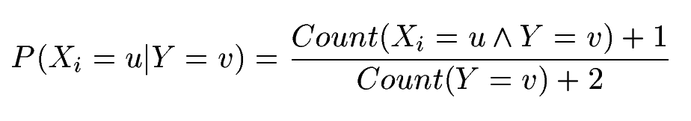
Naïve Bayes Training
In practice, some of these counts can be zero
Fix this by adding “virtual” counts:
  (This is like putting a prior on parameters and doing MAP estimation instead of MLE)
  This is called Smoothing

Slide 32
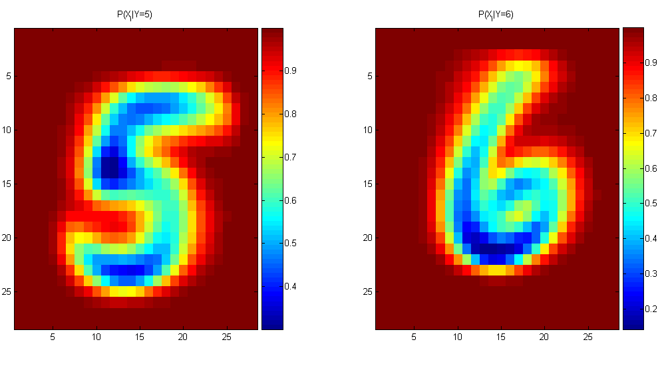
Naïve Bayes Training
For binary digits, training amounts to averaging all of the training fives together and all of the training sixes together.

Slide 33
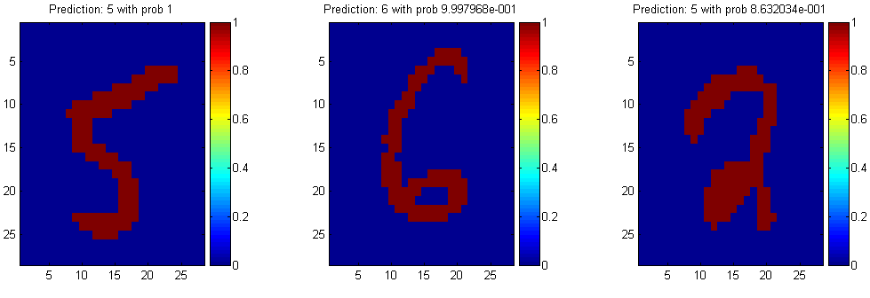
Naïve Bayes Classification

Slide 34
Another Example of the Naïve Bayes Classifier
The weather data, with counts and probabilities
outlook |  |  | temperature |  |  | humidity |  |  | windy |  |  | play
 | yes | no |  | yes | no |  | yes | no |  | yes | no | yes | no
sunny | 2 | 3 | hot | 2 | 2 | high | 3 | 4 | false | 6 | 2 | 9 | 5
overcast | 4 | 0 | mild | 4 | 2 | normal | 6 | 1 | true | 3 | 3
rainy | 3 | 2 | cool | 3 | 1
sunny | 2/9 | 3/5 | hot | 2/9 | 2/5 | high | 3/9 | 4/5 | false | 6/9 | 2/5 | 9/14 | 5/14
overcast | 4/9 | 0/5 | mild | 4/9 | 2/5 | normal | 6/9 | 1/5 | true | 3/9 | 3/5
rainy | 3/9 | 2/5 | cool | 3/9 | 1/5
A new day
outlook | temperature | humidity | windy | play
sunny | cool | high | true | ?

Slide 35
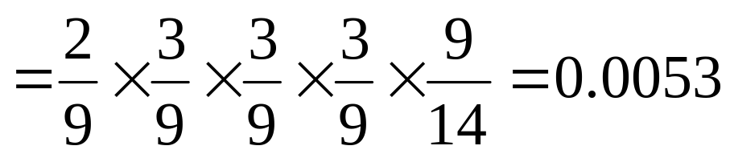
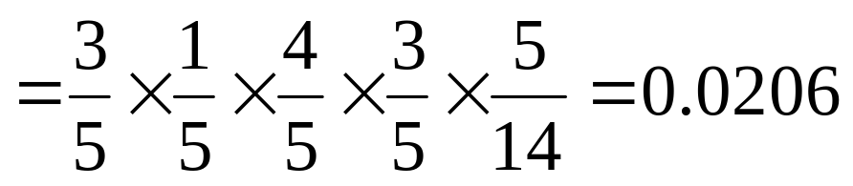
Likelihood of yes
Likelihood of no
Therefore, the prediction is No

Slide 36
The Naive Bayes Classifier for Data Sets with Numerical Attribute Values
One common practice to handle numerical attribute values is to assume normal distributions for numerical attributes.

Slide 37
The numeric weather data with summary statistics
outlook |  |  | temperature |  |  | humidity |  |  | windy |  |  | play
 | yes | no |  | yes | no |  | yes | no |  | yes | no | yes | no
sunny | 2 | 3 |  | 83 | 85 |  | 86 | 85 | false | 6 | 2 | 9 | 5
overcast | 4 | 0 |  | 70 | 80 |  | 96 | 90 | true | 3 | 3
rainy | 3 | 2 |  | 68 | 65 |  | 80 | 70
 |  |  |  | 64 | 72 |  | 65 | 95
 |  |  |  | 69 | 71 |  | 70 | 91
 |  |  |  | 75 |  |  | 80
 |  |  |  | 75 |  |  | 70
 |  |  |  | 72 |  |  | 90
 |  |  |  | 81 |  |  | 75
sunny | 2/9 | 3/5 | mean | 73 | 74.6 | mean | 79.1 | 86.2 | false | 6/9 | 2/5 | 9/14 | 5/14
overcast | 4/9 | 0/5 | std dev | 6.2 | 7.9 | std dev | 10.2 | 9.7 | true | 3/9 | 3/5
rainy | 3/9 | 2/5

Slide 38
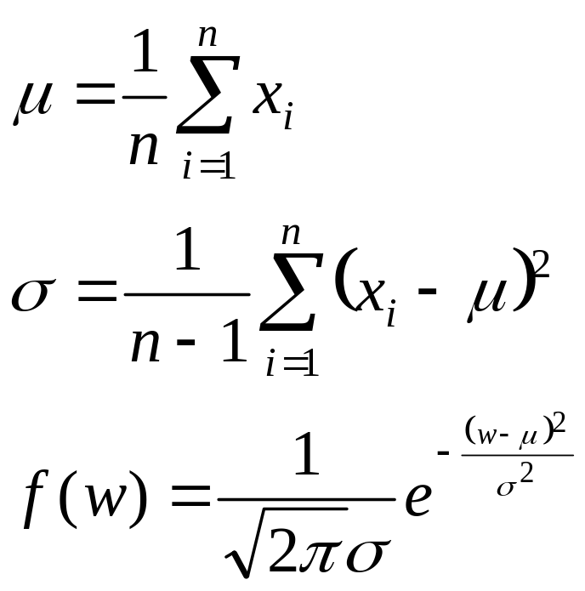
Let x₁, x₂, …, x_{n} be the values of a numerical attribute in the training data set.

Slide 39
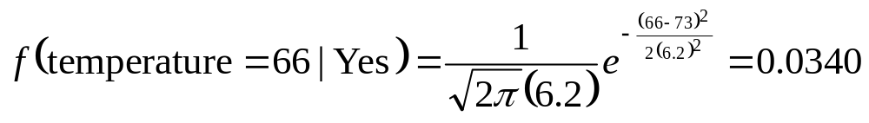
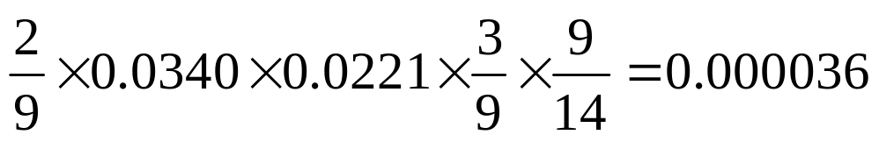
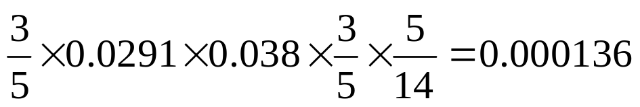
For examples,
Likelihood of Yes =
Likelihood of No =

Slide 40
Outputting Probabilities
What’s nice about Naïve Bayes (and generative models in general) is that it returns probabilities
  These probabilities can tell us how confident the algorithm is
  So… don’t throw away those probabilities!

Slide 41
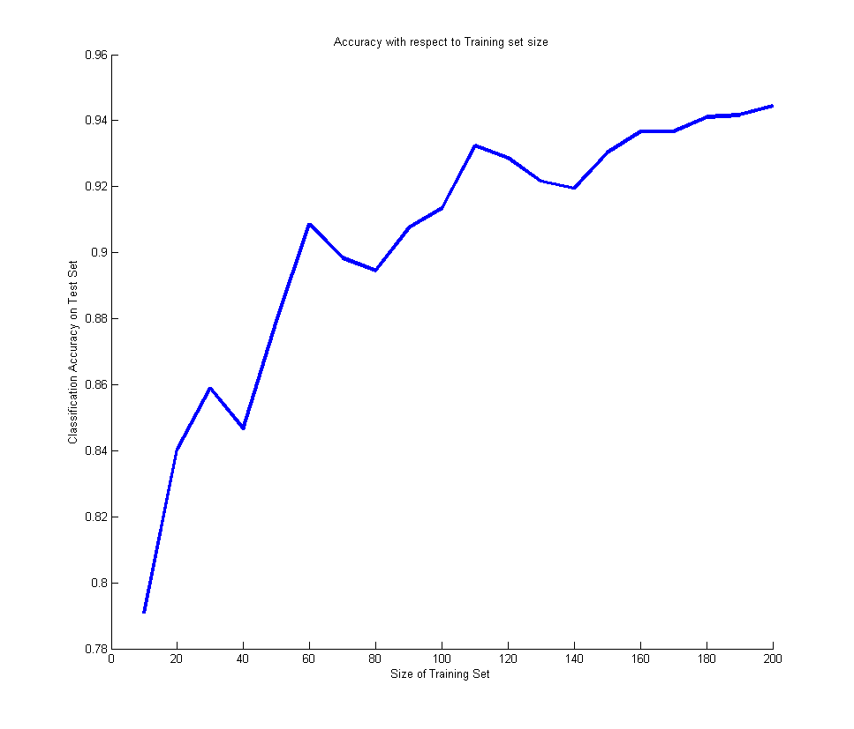
Performance on a Test Set
Naïve Bayes is often a good choice if you don’t have much training data!

Slide 42
Naïve Bayes Assumption
Recall the Naïve Bayes assumption:
  that all features are independent given the class label Y
Does this hold for the digit recognition problem?

Slide 43
Exclusive-OR Example
For an example where conditional independence fails:
  Y=XOR(X₁,X₂)
X₁ | X₂ | P(Y=0|X₁,X₂) | P(Y=1|X₁,X₂)
0 | 0 | 1 | 0
0 | 1 | 0 | 1
1 | 0 | 0 | 1
1 | 1 | 1 | 0

Slide 44
Actually, the Naïve Bayes assumption is almost never true
Still… Naïve Bayes often performs surprisingly well even when its assumptions do not hold

Slide 45
Numerical Stability
It is often the case that machine learning algorithms need to work with very small numbers
  Imagine computing the probability of 2000 independent coin flips
  MATLAB thinks that (.5)²⁰⁰⁰=0

Slide 46
Underflow Prevention
Multiplying lots of probabilities
➔ floating-point underflow.
Recall: log(xy) = log(x) + log(y),
➔ better to sum logs of probabilities rather than multiplying probabilities.

Slide 47
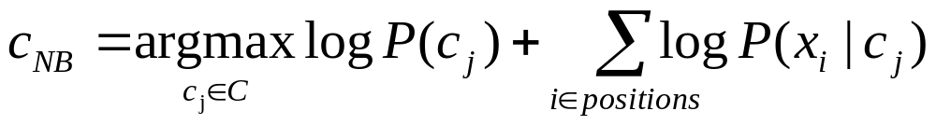
Underflow Prevention
Class with highest final un-normalized log probability score is still the most probable.

Slide 48
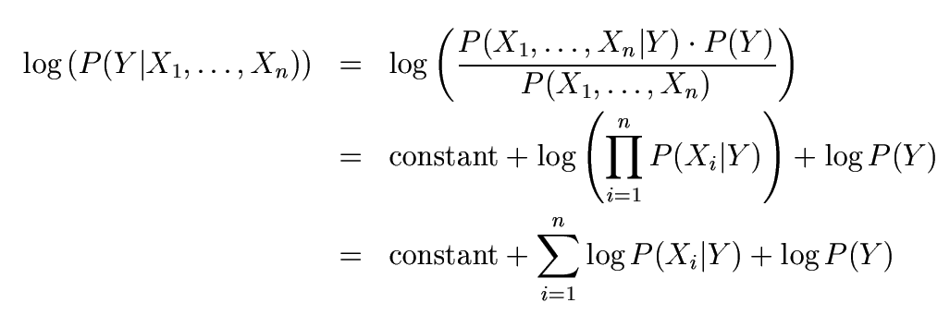
Numerical Stability
Instead of comparing P(Y=5|X₁,…,X_{n}) with P(Y=6|X₁,…,X_{n}),
  Compare their logarithms

Slide 49


Recovering the Probabilities
What if we want the probabilities though??
Suppose that for some constant K, we have:
  And
How would we recover the original probabilities?

Slide 50

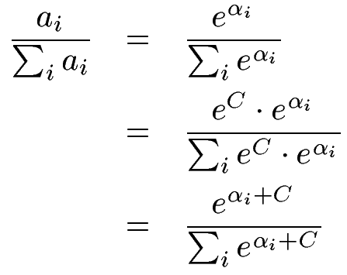

Recovering the Probabilities
Given:
Then for any constant C:
One suggestion: set C such that the greatest α_{i} is shifted to zero:
See https://stats.stackexchange.com/questions/105602/example-of-how-the-log-sum-exp-trick-works-in-naive-bayes?noredirect=1&lq=1

Slide 51
Recap
We defined a Bayes classifier but saw that it’s intractable to compute P(X₁,…,X_{n}|Y)
We then used the Naïve Bayes assumption – that everything is independent given the class label Y
A natural question: is there some happy compromise where we only assume that some features are conditionally independent?
  Stay Tuned…

Slide 52
Conclusions
Naïve Bayes is:
  Really easy to implement and often works well
  Often a good first thing to try
  Commonly used as a “punching bag” for smarter algorithms

Slide 53
Evaluating classification algorithms
You have designed a new classifier.
You give it to me, and I try it on my image dataset

Slide 54
Evaluating classification algorithms
I tell you that it achieved 95% accuracy on my data.
Is your technique a success?

Slide 55
Types of errors
But suppose that
  The 95% is the correctly classified pixels
  Only 5% of the pixels are actually edges
  It misses all the edge pixels
How do we count the effect of different types of error?

Slide 56
Types of errors
Prediction
Edge Not edge
Ground Truth
Not Edge Edge
True Positive | False Negative
False Positive | True Negative

Slide 57
Two parts to each: whether you got it correct or not, and what you guessed. For example for a particular pixel, our guess might be labelled…
True Positive
Did we get it correct? True, we did get it correct.
What did we say? We said ‘positive’, i.e. edge.
or maybe it was labelled as one of the others, maybe…
False Negative
Did we get it correct? False, we did not get it correct.
What did we say? We said ‘negative, i.e. not edge.

Slide 58
Sensitivity and Specificity
Count up the total number of each label (TP, FP, TN, FN) over a large dataset. In ROC analysis, we use two statistics:
TP
Can be thought of as the likelihood of spotting a positive case when presented with one.
Or… the proportion of edges we find.
Sensitivity =
TP+FN
TN
Can be thought of as the likelihood of spotting a negative case when presented with one.
Or… the proportion of non-edges that we find
Specificity =
TN+FP

Slide 59
TP
TN
Sensitivity = = ?
Specificity = = ?
TP+FN
TN+FP
Prediction
1
0
60+30 = 90 cases in the dataset were class 1 (edge)
1
60
30
Ground Truth
0
80+20 = 100 cases in the dataset were class 0 (non-edge)
80
20
90+100 = 190 examples (pixels) in the data overall

Slide 60
The ROC space
1.0
This is edge detector A
This is edge detector B
Sensitivity
0.0
1.0
1 - Specificity
Note

Slide 61
The ROC Curve
Draw a ‘convex hull’ around many points:
Sensitivity
This point is not on the convex hull.
1 - Specificity

Slide 62
ROC Analysis
All the optimal detectors lie on the convex hull.
Which of these is best depends on the ratio of edges to non-edges, and the different cost of misclassification
Any detector on this side can lead to a better detector by flipping its output.
sensitivity
1 - specificity
Take-home point : You should always quote sensitivity and specificity for your algorithm, if possible plotting an ROC graph. Remember also though, any statistic you quote should be an average over a suitable range of tests for your algorithm.

Slide 63
Holdout estimation
What to do if the amount of data is limited?
The holdout method reserves a certain amount for testing and uses the remainder for training
  ➔Usually: one third for testing, the rest for training

Slide 64
Holdout estimation
Problem: the samples might not be representative
  Example: class might be missing in the test data
Advanced version uses stratification
  Ensures that each class is represented with approximately equal proportions in both subsets

Slide 65
Repeated holdout method
Repeat process with different subsamples
➔ more reliable
  In each iteration, a certain proportion is randomly selected for training (possibly with stratificiation)
  The error rates on the different iterations are averaged to yield an overall error rate

Slide 66
Repeated holdout method
Still not optimum: the different test sets overlap
  Can we prevent overlapping?
  Of course!

Slide 67
Cross-validation
Cross-validation avoids overlapping test sets
  First step: split data into k subsets of equal size
  Second step: use each subset in turn for testing, the remainder for training
Called k-fold cross-validation

Slide 68
Cross-validation
Often the subsets are stratified before the cross-validation is performed
The error estimates are averaged to yield an overall error estimate

Slide 69
More on cross-validation
Standard method for evaluation: stratified ten-fold cross-validation
Why ten?
  Empirical evidence supports this as a good choice to get an accurate estimate
  There is also some theoretical evidence for this
Stratification reduces the estimate’s variance
Even better: repeated stratified cross-validation
  E.g. ten-fold cross-validation is repeated ten times and results are averaged (reduces the variance)

Slide 70
Leave-One-Out cross-validation
Leave-One-Out:
a particular form of cross-validation:
  Set number of folds to number of training instances
  I.e., for n training instances, build classifier n times
Makes best use of the data
Involves no random subsampling
Very computationally expensive
  (exception: NN)

Slide 71
Leave-One-Out-CV and stratification
Disadvantage of Leave-One-Out-CV: stratification is not possible
  It guarantees a non-stratified sample because there is only one instance in the test set!

Slide 72
Hands-on Example
# Import Bayes.csv from class webpage
# Select training data
traindata <- Bayes[1:14,]
# Select test data
testdata <- Bayes[15,]

Slide 73
Construct Naïve Bayes Classifier the hard way
# Calculate the Prior for Play
Pplay <- table(traindata$Play)
Pplay <- Pplay/sum(Pplay)
# Calculate P(Sunny | Play)
sunny <- table(traindata[,c("Play", "Sunny")])
sunny <- sunny/rowSums(sunny)

Slide 74
# Calculate P(Hot | Play)
hot <- table(traindata[,c("Play", "Hot")])
hot <- hot/rowSums(hot)
# and Calculate P(Windy | Play)
windy <- table(traindata[,c("Play", "Windy")])
windy <- windy/rowSums(windy)

Slide 75
# Evaluate testdata
Pyes <- sunny["Yes","Yes"] * hot["Yes","No"] * windy["Yes","Yes"]
Pno <- sunny["No","Yes"] * hot["No","No"] * windy["No","Yes"]
# Do we play or not?
Max(Pyes, Pno)

Slide 76
# Do it again, but use the naiveBayes package
# install the package if you don’t already have it
install.packages("e1071")
#load package
library(e1071)
#train model
m <- naiveBayes(traindata[,1:3], traindata[,4])
#evaluate testdata
predict(m,testdata[,1:3])

Slide 77
# use the naïveBayes classifier on the iris data
m <- naiveBayes(iris[,1:4], iris[,5])
table(predict(m, iris[,1:4]), iris[,5])

Slide 78
Questions?

